Slide 3
Build a bot for Microsoft Teams in 5 minutes
Stephan Bisser
THR2426

Slide 4





Stephan Bisser Microsoft MVP (AI) https://www.cloudguy.pro @cloudguy_pro #AskCloudguy Graz, Austria
http://bit.ly/LEARN_TO_BOT

Slide 5
What to expect from today’s session
Objectives
Key Takeaways
See a quick example of how easy it is to build a Q&A bot for Teams with QnA Maker and App Studio
Learn how you can extend your basic bot with more Teams app capabilities
Start building a bot for Teams using QnA Maker!

Slide 6

Microsoft Teams provides a powerful and extensible platform
Build apps using rich capabilities to empower your users in chat, channels, and personal workspace
Distribute and manage your app
Enterprise Developers
Upload to your organization’s app catalog
Tabs
Bots
Surface rich content within Teams
Help users get tasks done in conversations
ISVs Partners
Publish to AppSource to make available in the Teams app store
Messaging Extensions
Notifications
Allow users to query and share rich cards in conversations
Post rich updates to channels via connectors
Administrators
Assign policy for apps over end users. Preinstall and pre-pin apps to drive adoption
Adaptive Cards
Voice and video
Add rich interaction to your connector cards
Add rich calling and meeting automation and media
Microsoft Graph
Power your apps using Graph. Build intelligence and connect to data that drives productivity

Slide 7






real digital transformation
your app/service
tabs
connectors
adaptive cards
bots
messaging extensions
notifications
better business outcomes
Microsoft Teams
Notes:
Customers – may be internal or external

Slide 8



Modernizing the company FAQ
Use cases spanning departments, job functions
Company FAQ, powered by Azure Bot Service,
QnA Maker, and Teams
Departmental knowledge
FAQs for team-specific knowledge like acronyms, locations, pointers to documentation, and onboarding
Company info
+
+
+
Company wide like FAQs like corporate info, holidays/dates, and events
Troubleshooting/support
Create a support knowledge base that end users or agents can easily access

Slide 9
Build and connect your FAQ bot into Teams
Register your bot
Set up your Azure Bot Service and connect it to QnA Maker
1
2
Register in QnA Maker
Create a new service on the QnA Maker website and configure documents
Test in Web
Test Q&A functionality using the web client in Azure Bot Service
3
4
Connect to Teams
Use App Studio to create an app package that “wraps” your QnA Maker-based bot
Publish to Tenant App Catalog to distribute to end users in your org
Add capabilities
Add a tab, messaging extension, or other Teams app capability
5

Slide 10
DEMO

Slide 11
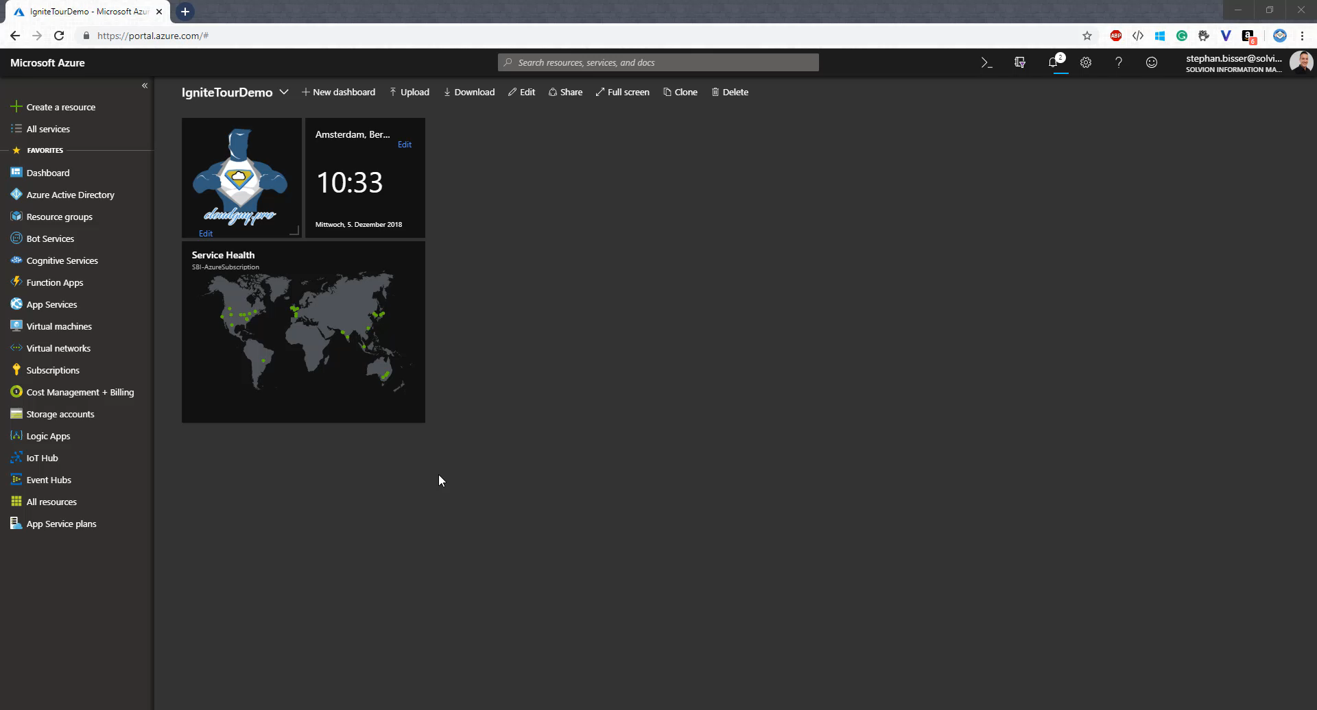

Slide 12
Setup QnAMaker.ai
Create Azure resources
Create new QnAMaker knowledgebase (https://www.qnamaker.ai)
Select websites or documents you want to populate your KB with * OR add QnA pairs manually
Review questions and answers
Test the service and make adjustments
Publish the QnA service
* Any document or website with question-answer pairs can be imported into QnA Maker

Slide 13
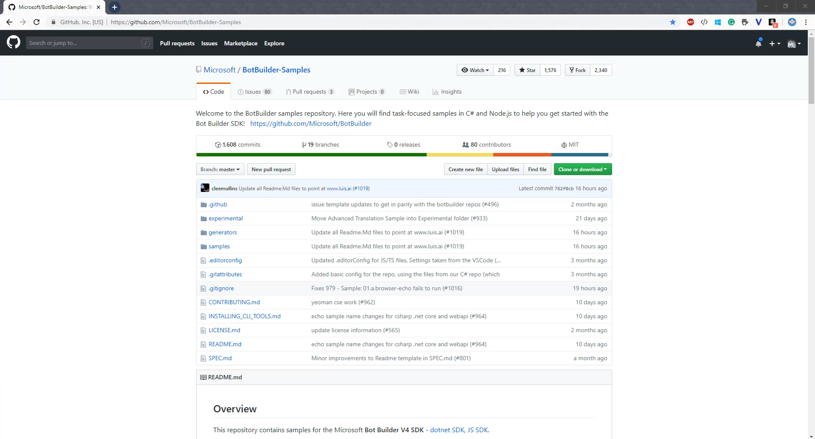
Local development setup
Download BotBuilder samples from https://github.com/Microsoft/BotBuilder-Samples
Open QnABot.csproj from Visual Studio
Add the QnAMaker keys to your .bot file *
Run the bot and test it locally with the Bot Framework emulator
* {
"type": "qna",
"subscriptionKey": "",
"name": "QnABot",
"KbId": "<yourKBID>",
"Hostname": "https://<yourHostName>.azurewebsites.net/qnamaker",
"EndpointKey": "<yourEndPointKey>",
"id": "117"
}

Slide 14
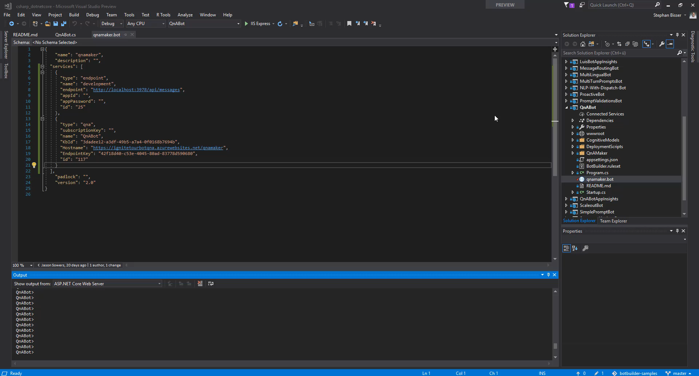
Publish bot to Azure
Publish your code from VS to Azure
Choose App Service as publish target and create new App Service *
Choose your resource group and publish
* You can also publish your code to an existing App Service

Slide 15
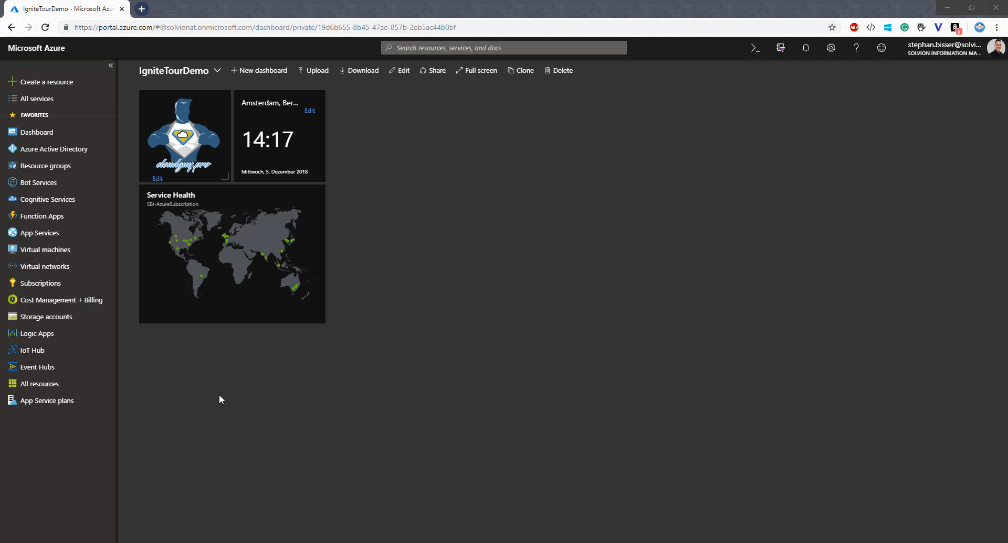
Register your bot with the Azure Bot Service
Create a new “Bot Channels Registration” instance from the Azure portal
Select your App Service URL + “api/messages” as the messaging endpoint for the channel registration *
Create App ID and password manually & copy them
Update your .bot file with App ID and password **
Publish code to Azure from VS
Test in Web Chat in Azure portal
** {
"appId": "<yourAppID>",
"appPassword": "<yourAppPasword>",
"endpoint": "https://<yourAppServiceName>.azurewebsites.net/api/messages",
"type": "endpoint",
"name": "production",
"id": "4"
}
* https://qnabotignitetour.azurewebsites.net/api/messages

Slide 16
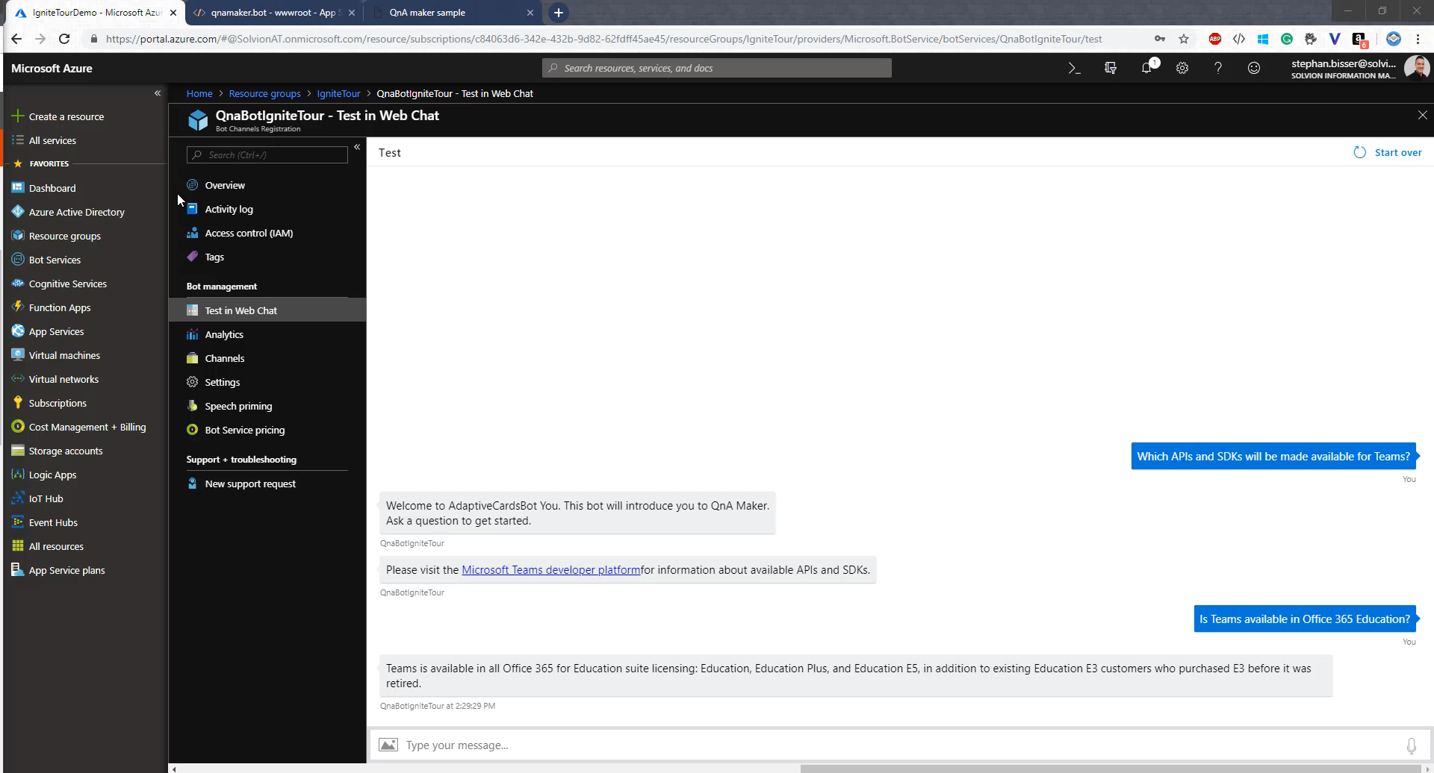
Add Microsoft Teams Channel
Navigate to ‘Channels’
Add Microsoft Teams channel
Paste App ID into Teams command bar and select People and select your bot
Start chatting with your bot in Teams 1:1 chat

Slide 17
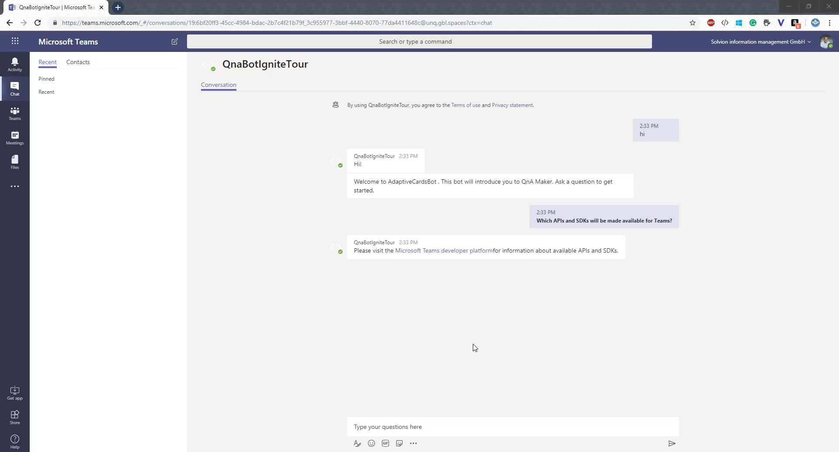
Create a Teams App using Teams App Studio
Go to the Manifest Editor in the Teams App Studio
Create a new app and fill out the details
Add bot by selecting Bots under capabilities
Paste in your App ID and select the scope of your bot (Personal or Team)
Test your bot by clicking Test and distribute and select the Team and Channel you want your bot deploy to
Start chatting with your bot in a channel using @mention

Slide 18
Next Steps
Visit www.qnamaker.ai to get started with your first FAQ bot
Check out aka.ms/teamsdevdocs to learn how to build a Teams app

